Slide 1
Online Labs and Virtual Communities

Slide 2
NUCLIO – Núcleo Interativo de Astronomia

Slide 3
Teachers with science in their fingertips
Teacher Training
Support Network
Teachers / Students
Adaptation to the curricula
Campaigns and accreditation
Best practice tools and resources

Slide 4
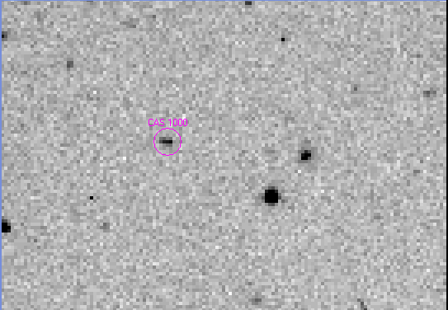
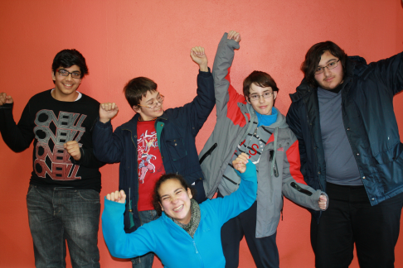
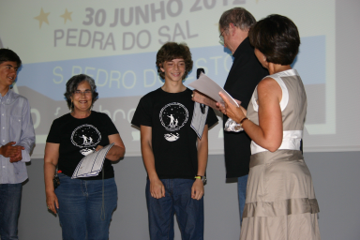
International Astronomical
Search Collaboration
Aluno = Aprendiz de Cientista
45 Countries
~ 500 Schools
~ 300 asteroids discovered by students
26 by portuguese students

Slide 5
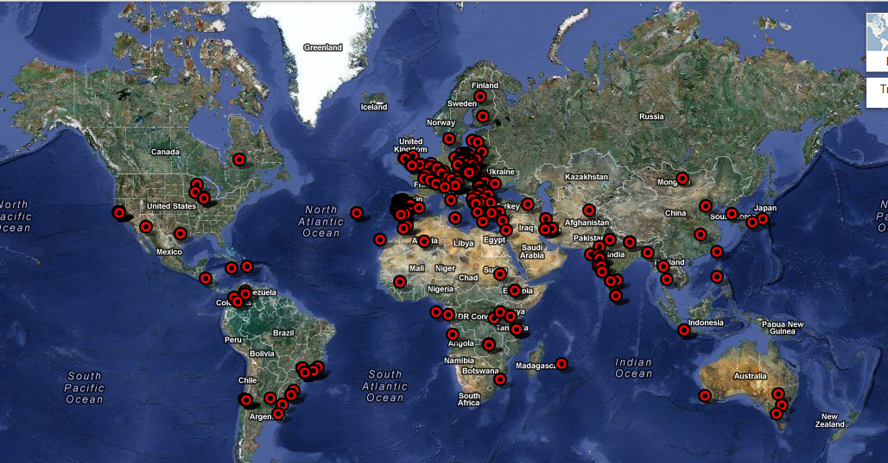
Sailing and discovering the world!!!
Representatives in 100 countries → 20 000 teachers involved in training sessions

Slide 6
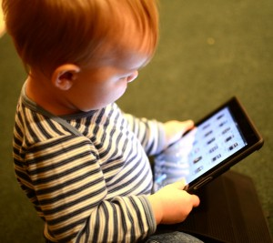
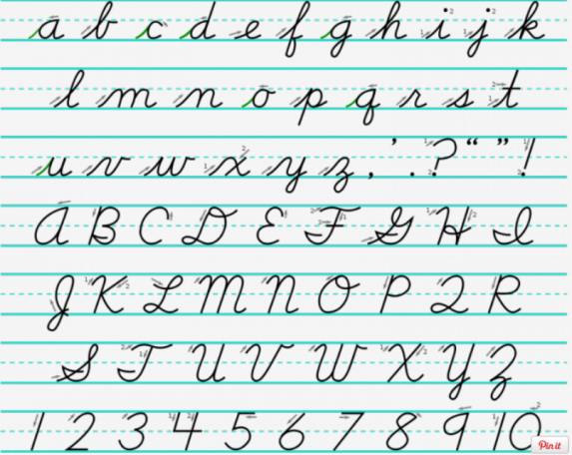
Future
Present
???
Past

Slide 7
Student centered learning

Slide 8
Partilha de recursos e ferramentas
Blogs
Forum
Hangouts
Etc
Criação de comunidades online
2000 Schools in Europe
10000 Teachers
portal.opendiscoveryspace.eu
50 parceiros de 23 países

Slide 9
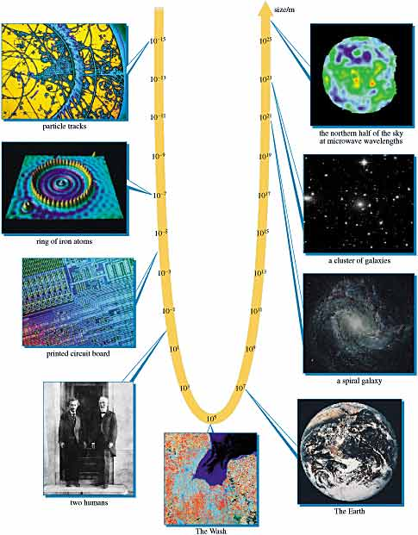
From small to big ideas in science.
Better problem solving skills
10 000 Schools in Europe

Slide 10
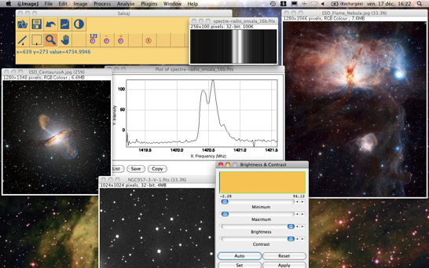
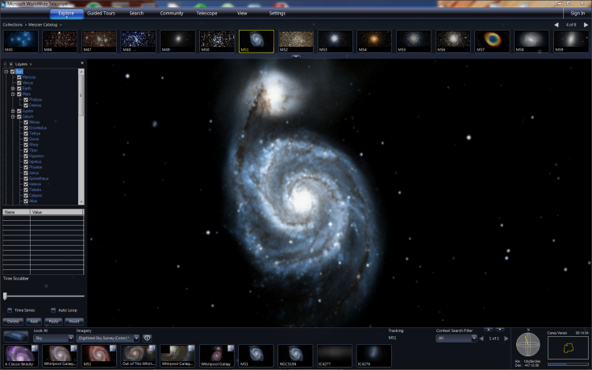
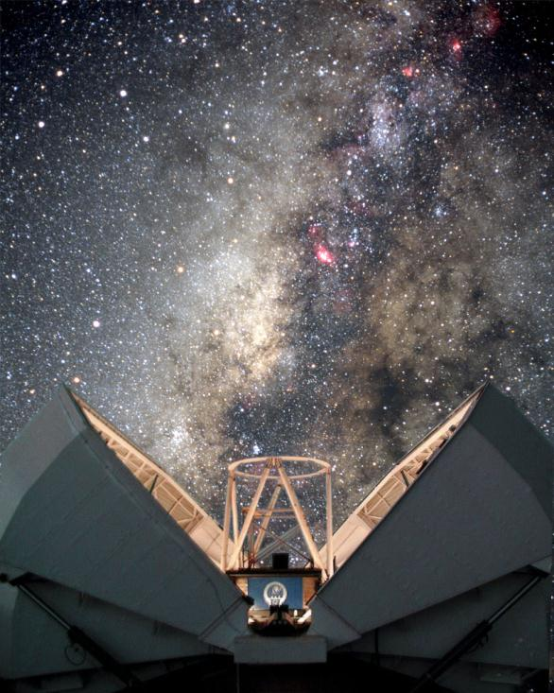

Slide 11
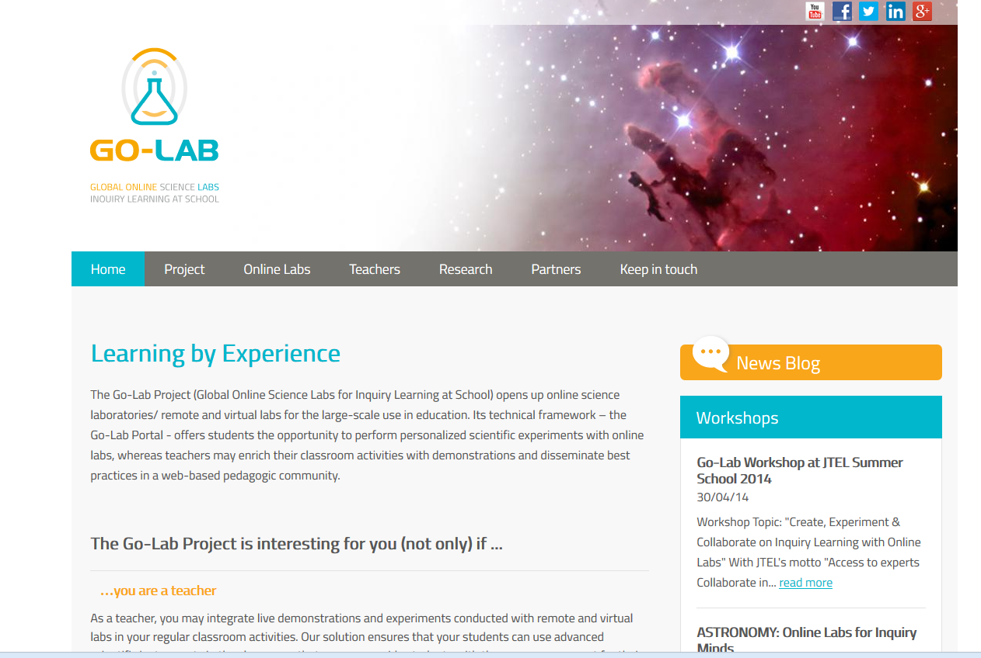
http://www.go-lab-project.eu/

Slide 12
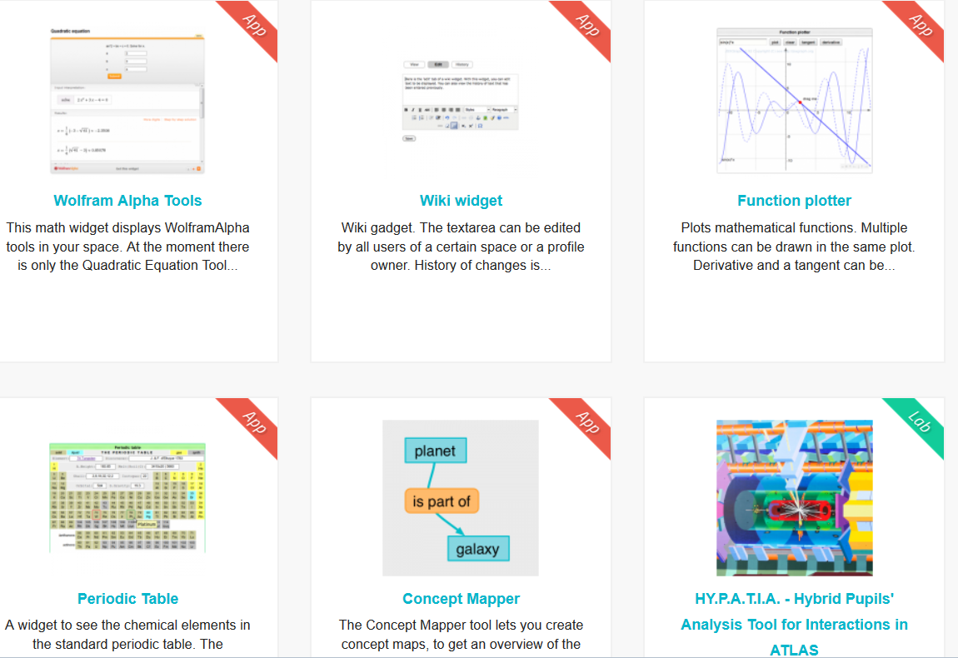
http://www.golabz.eu

Slide 13
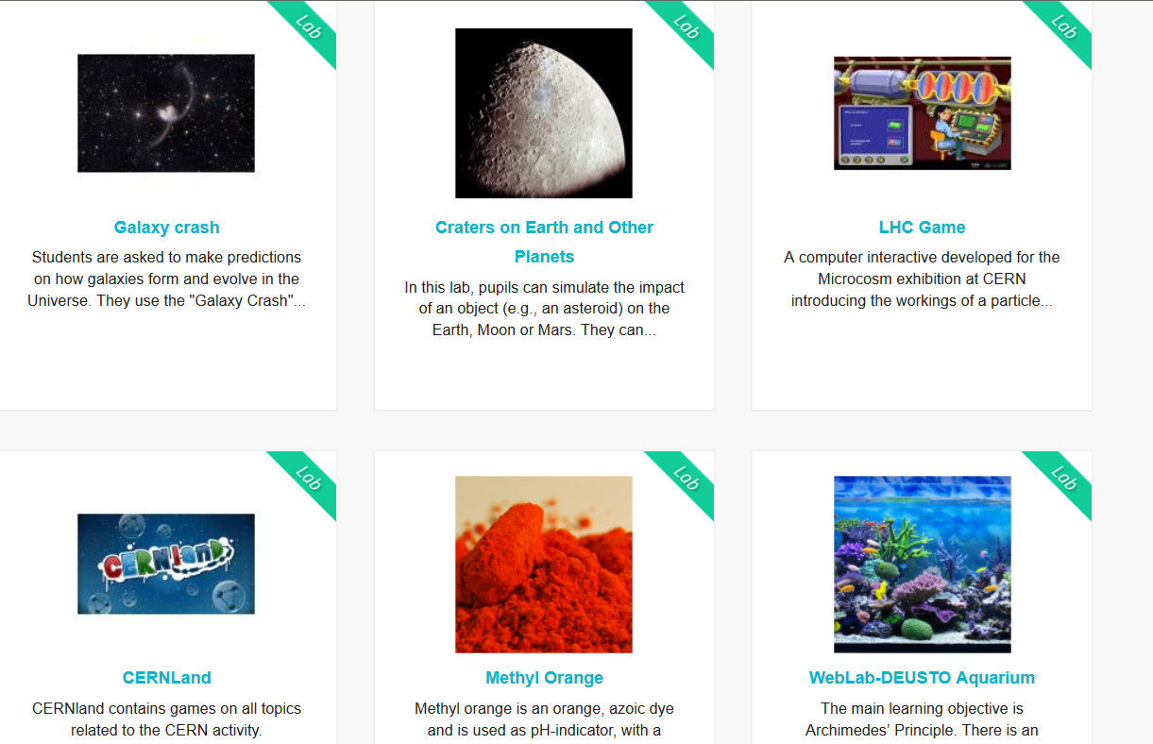
http://www.golabz.eu

Slide 14
Accreditation and suppor
Formação Certificada
Escolas
Professores
Estudantes
Apoio da Comunidade Local

Slide 15
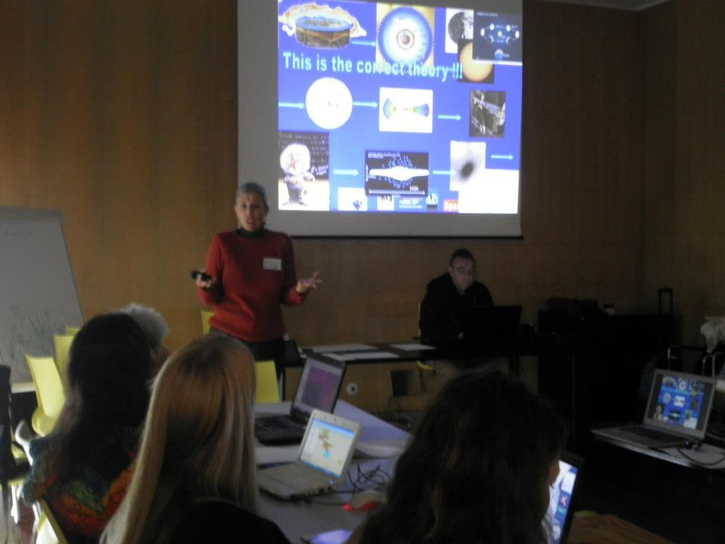
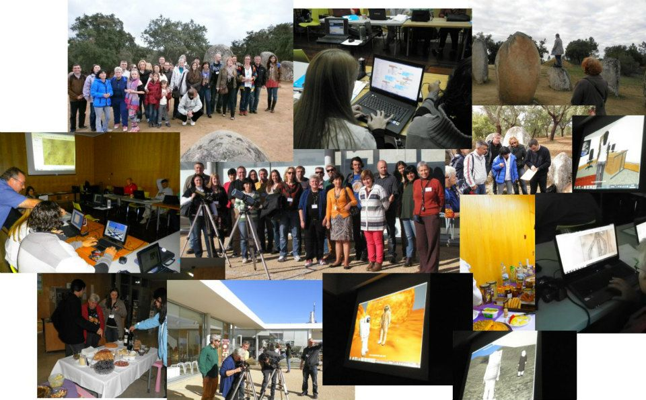
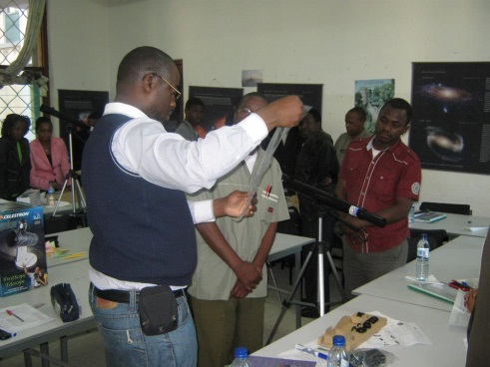
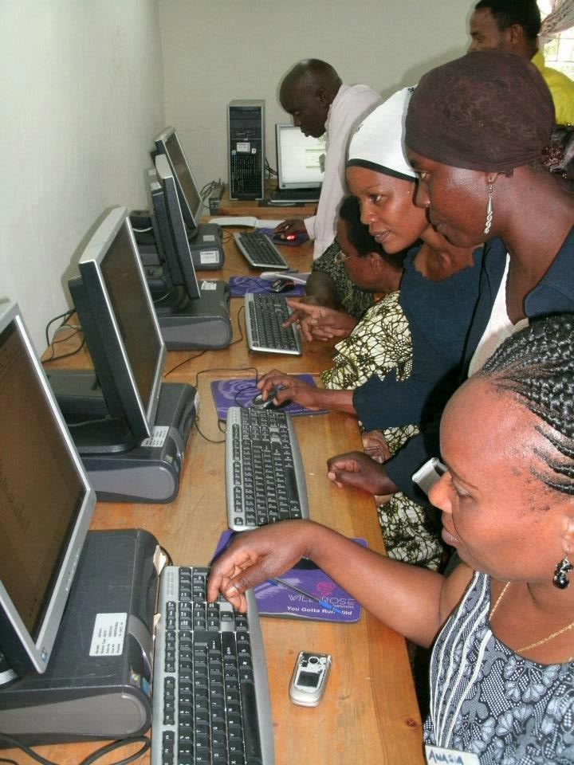
Teacher training sessions

Slide 16
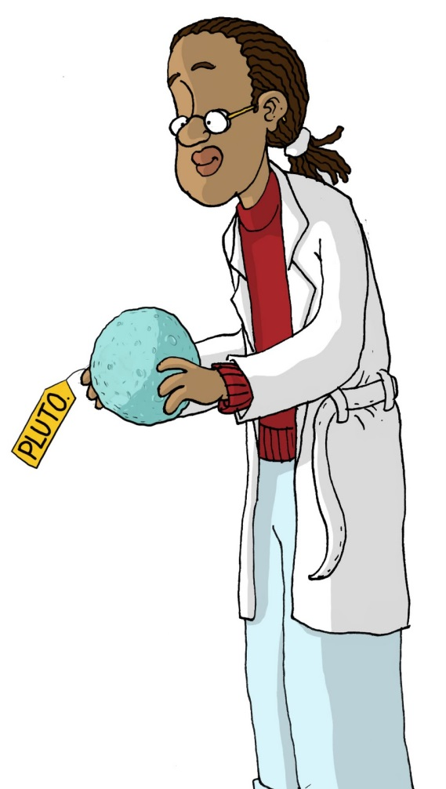
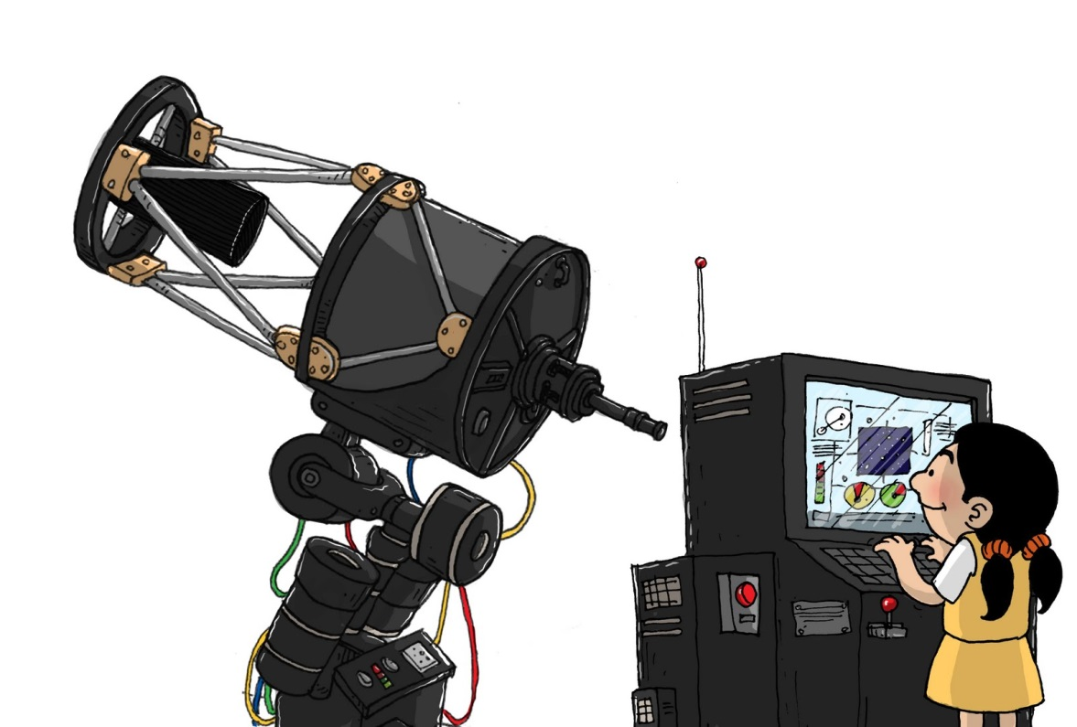
Implementing in school→ Galileo Teacher
© Manthan Educational Programme

Slide 17
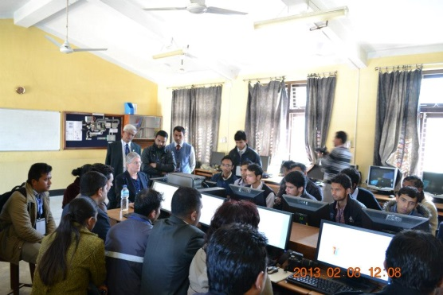
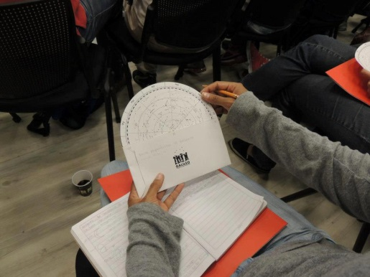
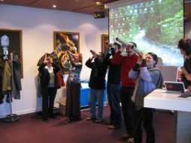
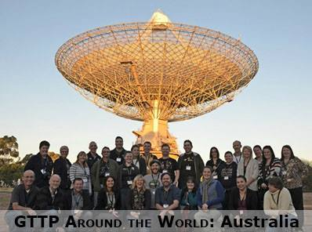
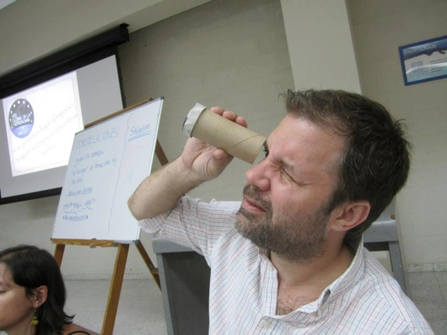
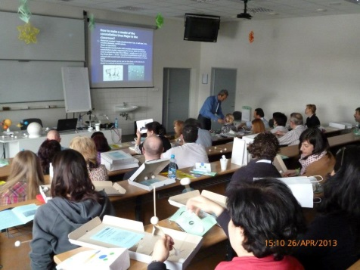
Training others → Galileo Ambassador
Cascade effect→ Slow …… Sustainable !!!

Slide 18
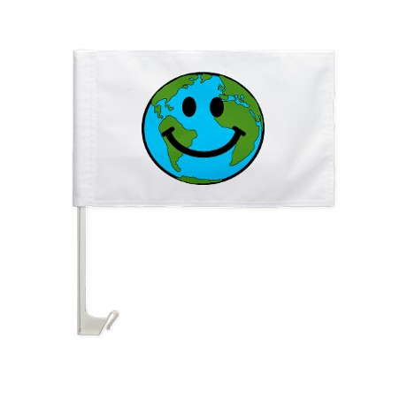
Galileo schools

Slide 19
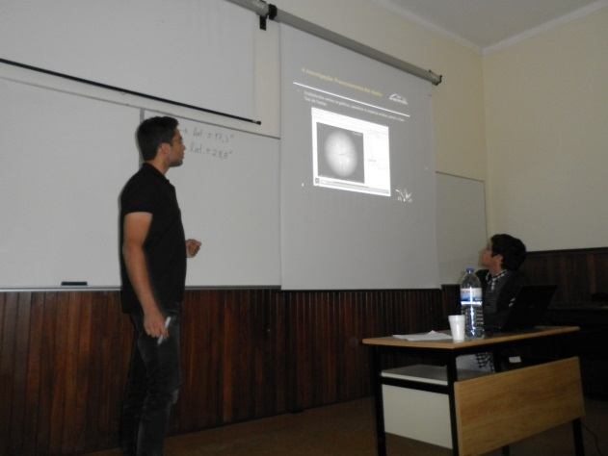
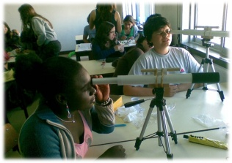
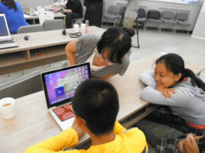
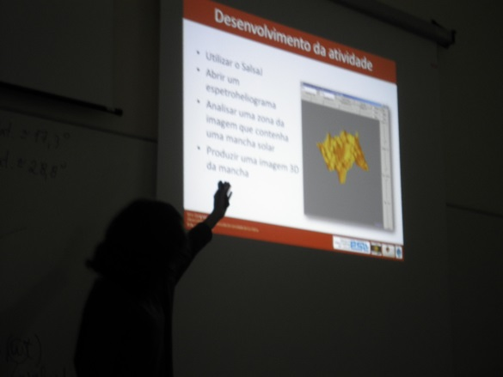
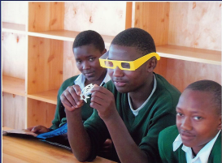
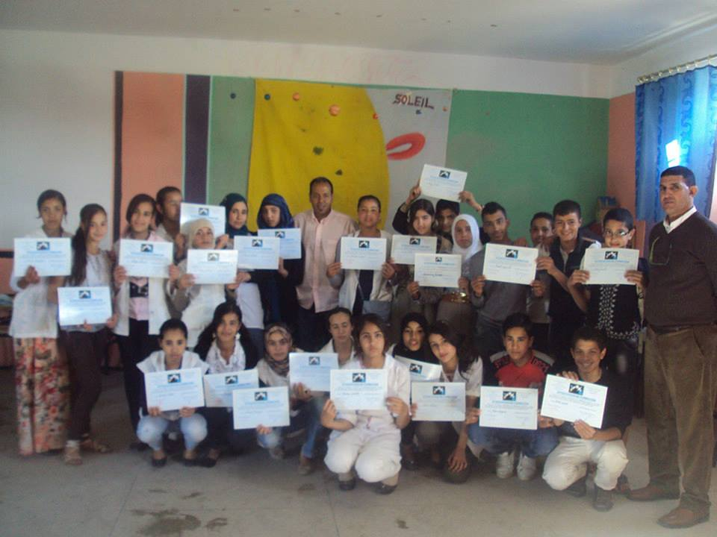
Galileo Students

Slide 20
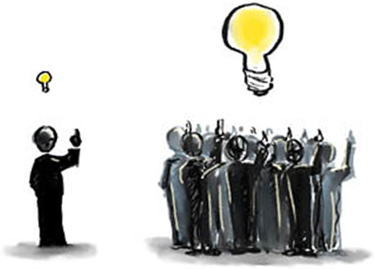
Building bridges and making the difference!!
competition
X
COOOLABORATION

Slide 21
Global citizenship
Cooperation between countries
Changing the world student by students, teacher by teacher
Sharing and support is the key to the real treasure!!

Slide 22
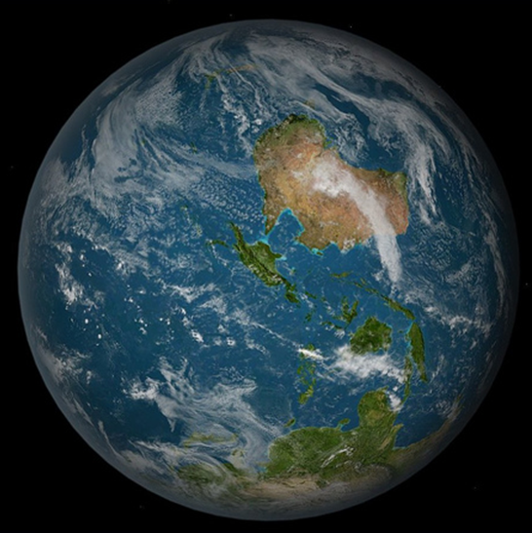
Value your tiny spot in this nice pale blue dot !!!
Obrigada!!!
rosa.doran@nuclio.pt

