Slide 1
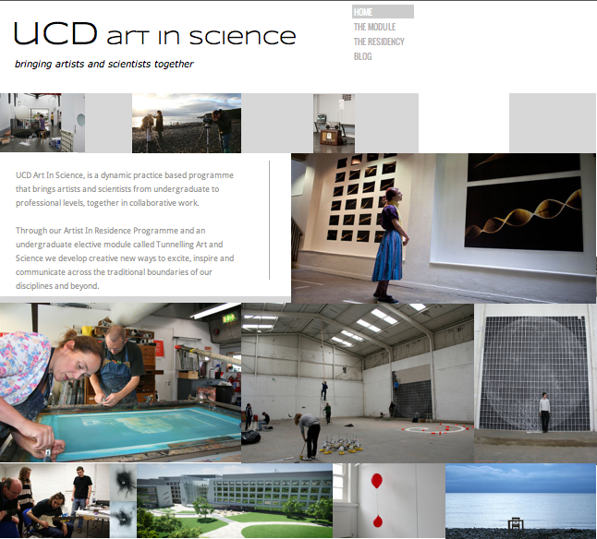
Emer O Boyle
Creative Director
UCD Art In Science
Artists In Residence
Collaborative module between students of Fine Art (NCAD) and Science (UCD)
www.ucdartinscience.com emer.oboyle@ucd.ie

Slide 2



An Online Art Science Collaboration
Artist Emer O Boyle, Astronomers Lorraine Hanlon UCD, Martin Topinka UCD, Robert Simpson UOXF
www.personal-space.eu

Slide 3
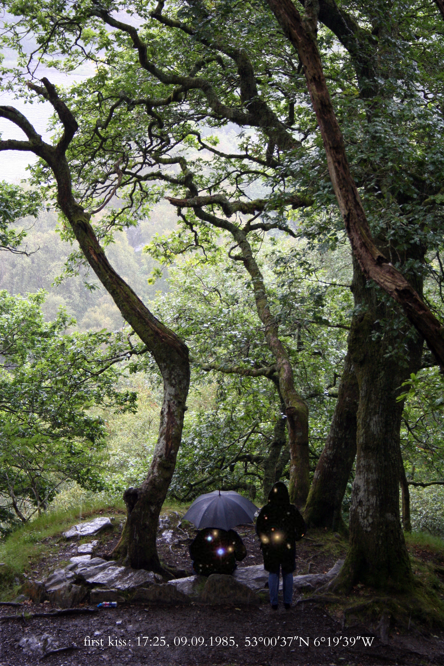
Where people can see a personal connection to the vast universe by linking significant moments
in their own lives to what was happening directly above and below them in the universe, at a specific time and place on earth.

Slide 4
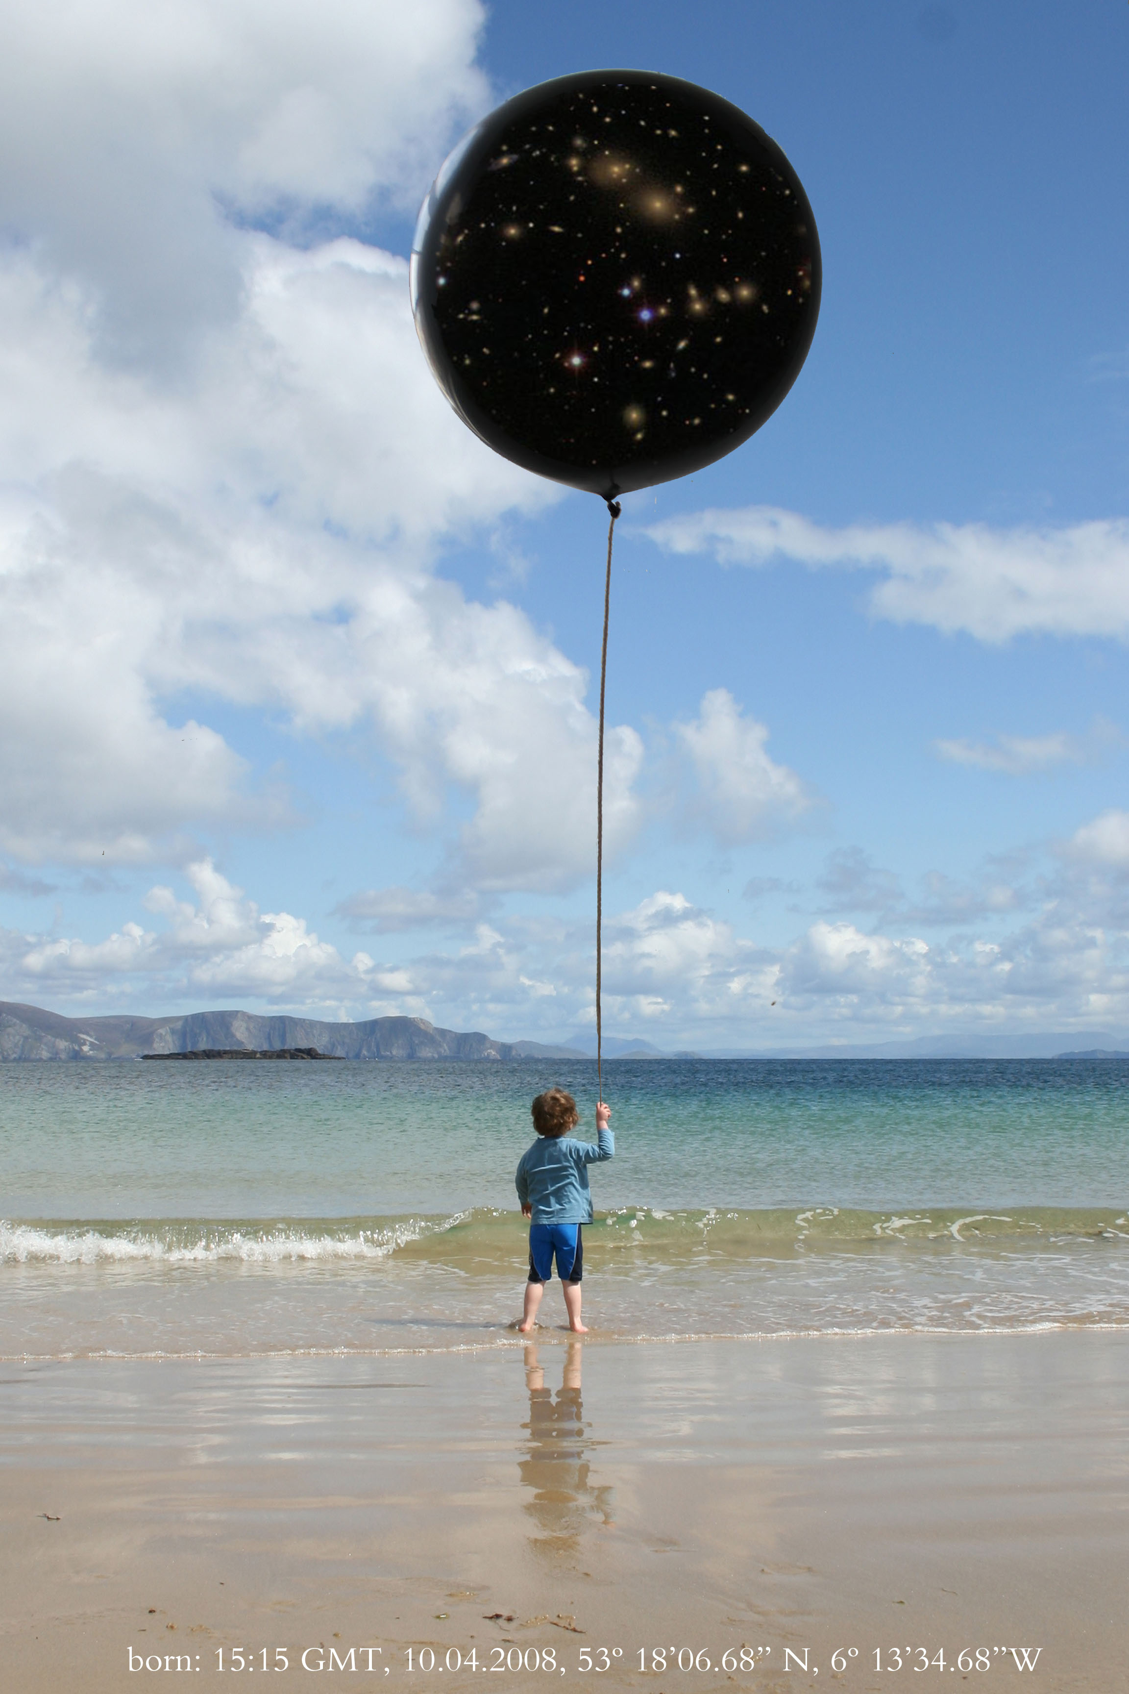
Looking at humanity’s place in nature, in the broadest sense, by mapping events of national and global significance to images of the universe and inviting others to see their own
Personal moments among these.

Slide 5
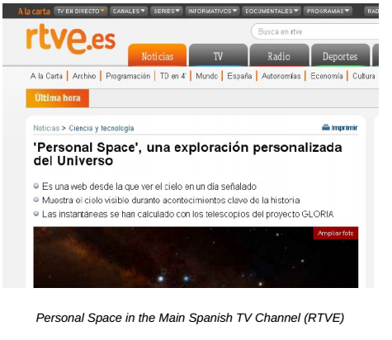
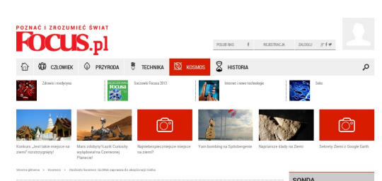
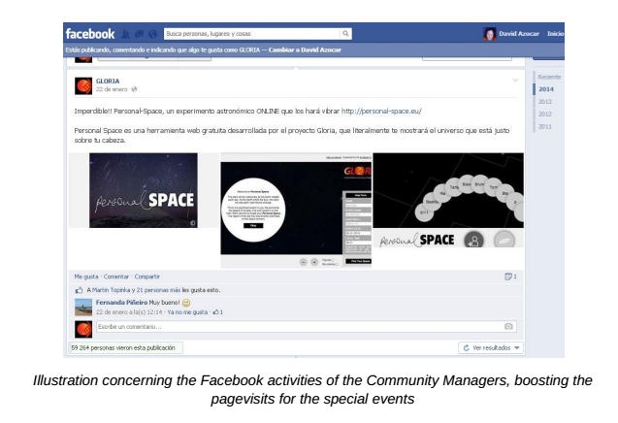
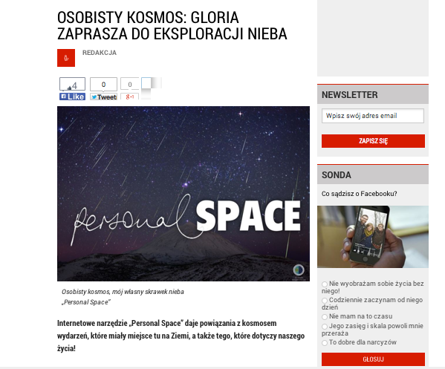
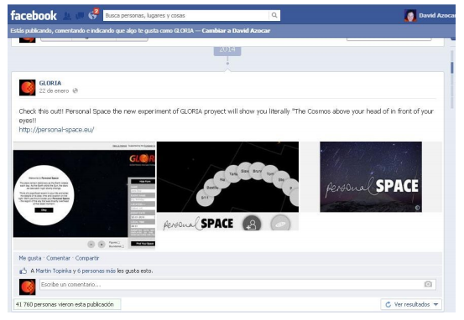
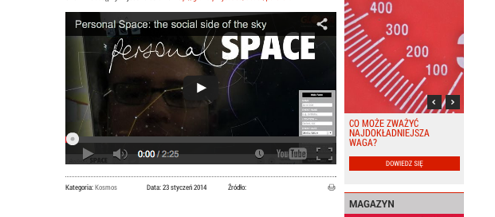
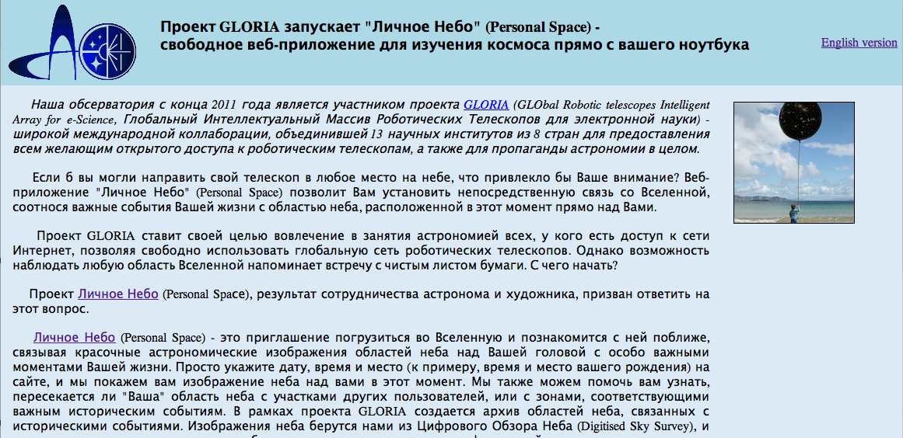
Launched across social media, press and television on January 22nd 2014

Slide 6
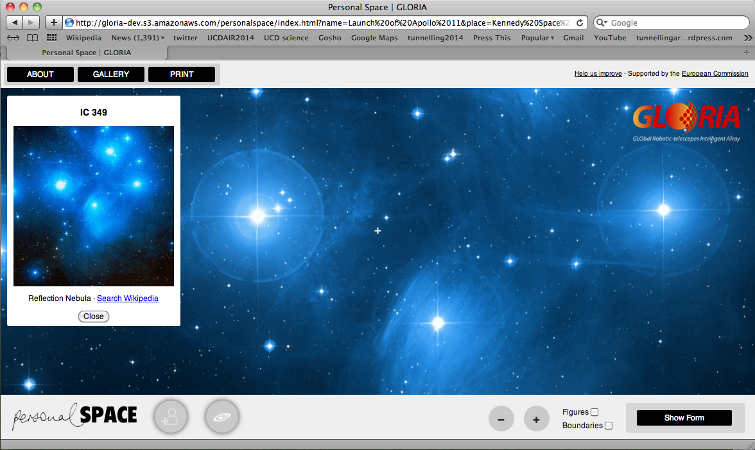
23,826 events already!

Slide 7
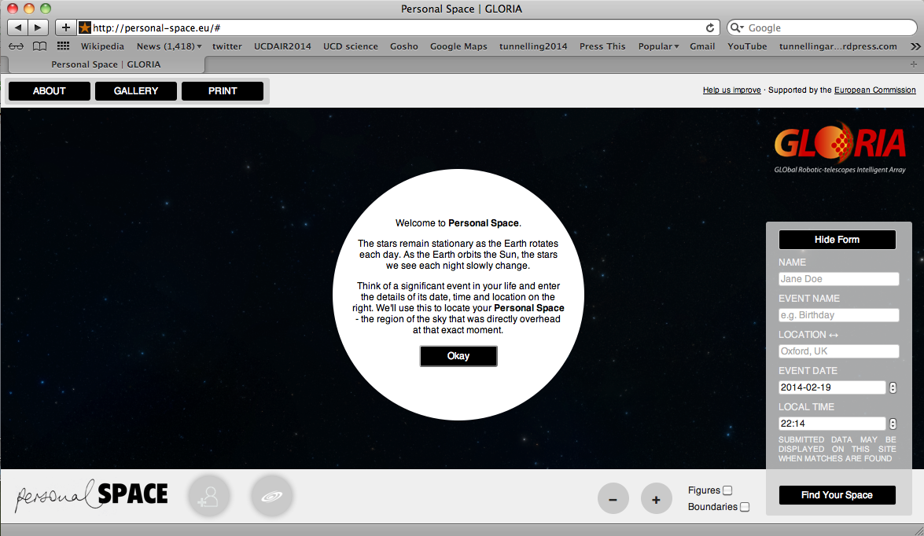

Slide 8
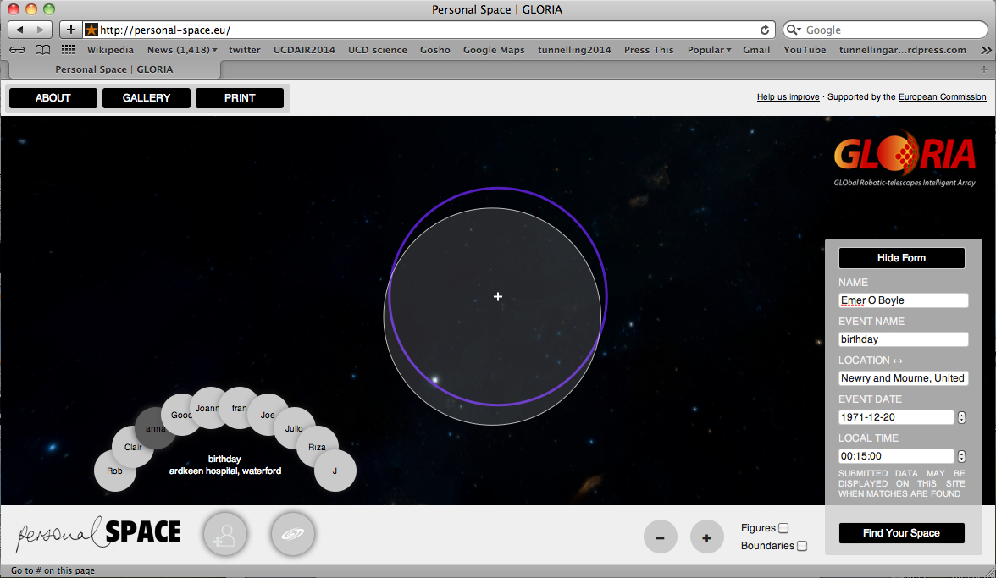

Slide 9
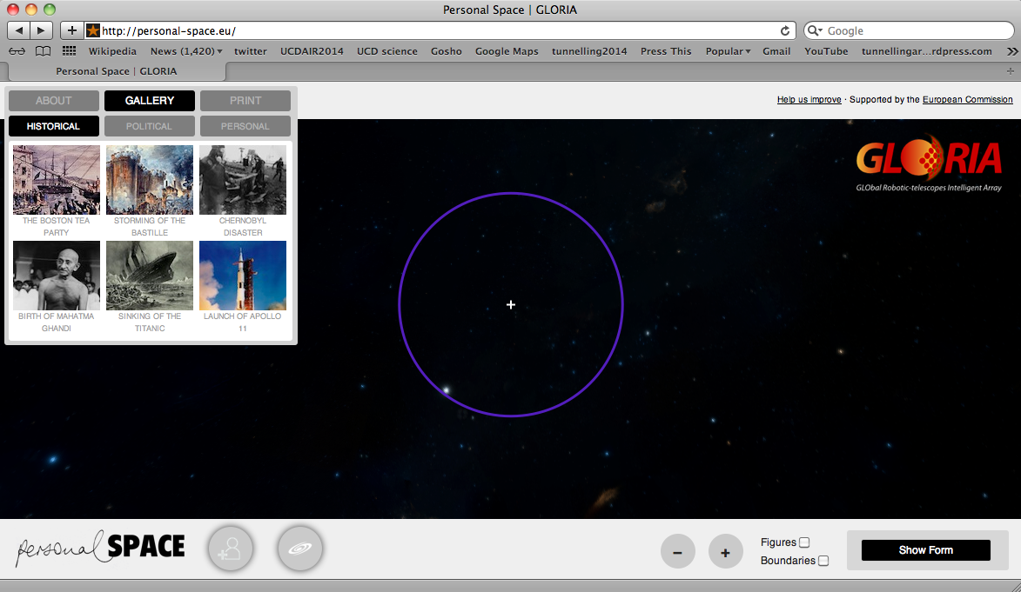

Slide 10
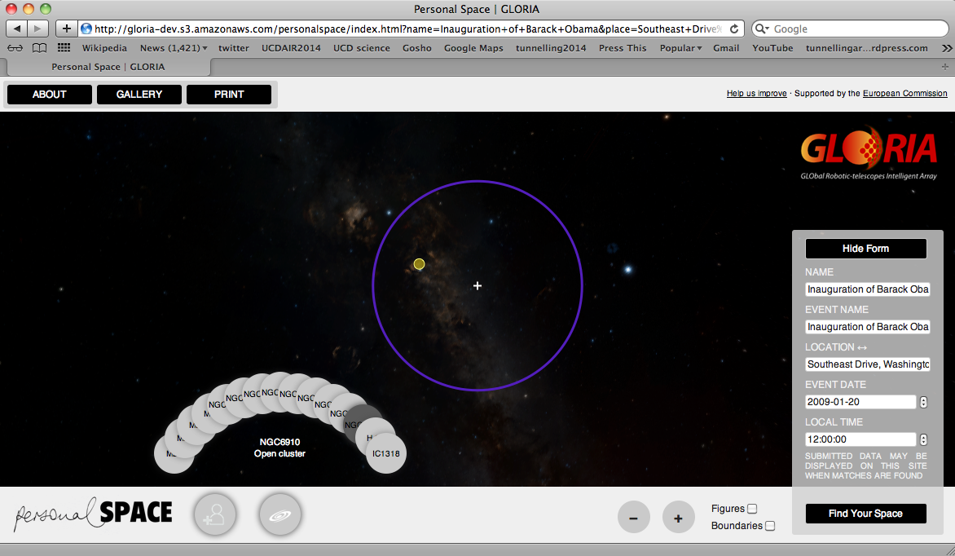

Slide 11
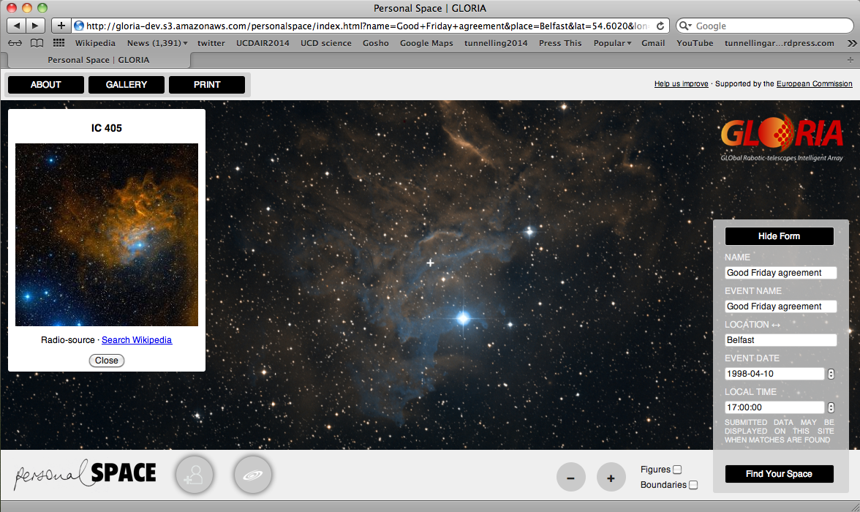

Slide 12
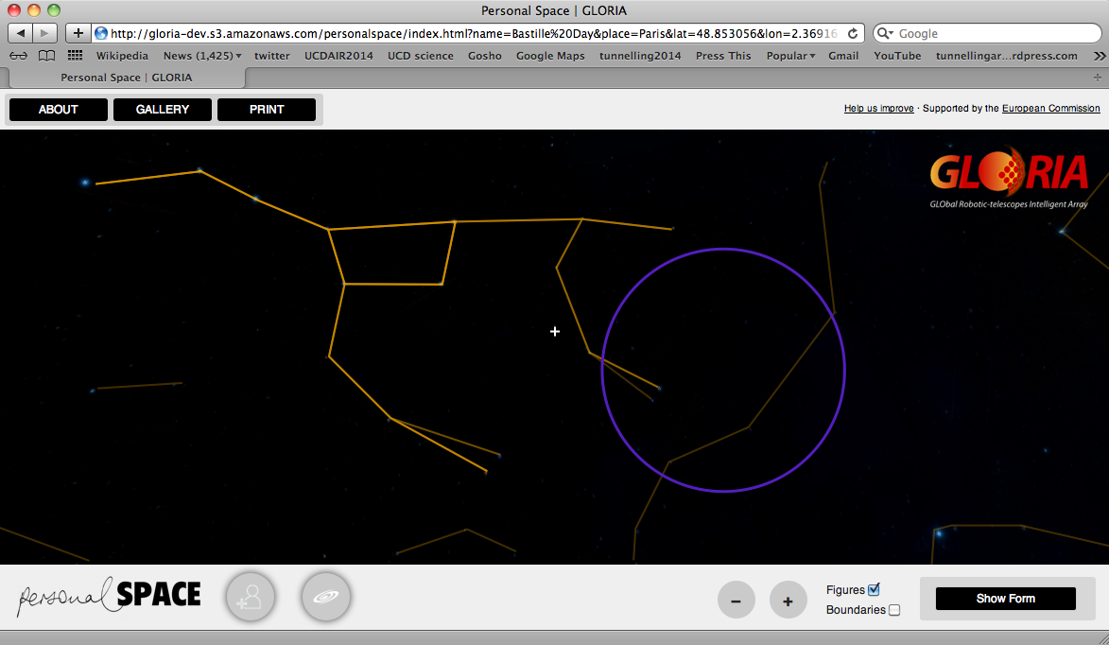

Slide 13
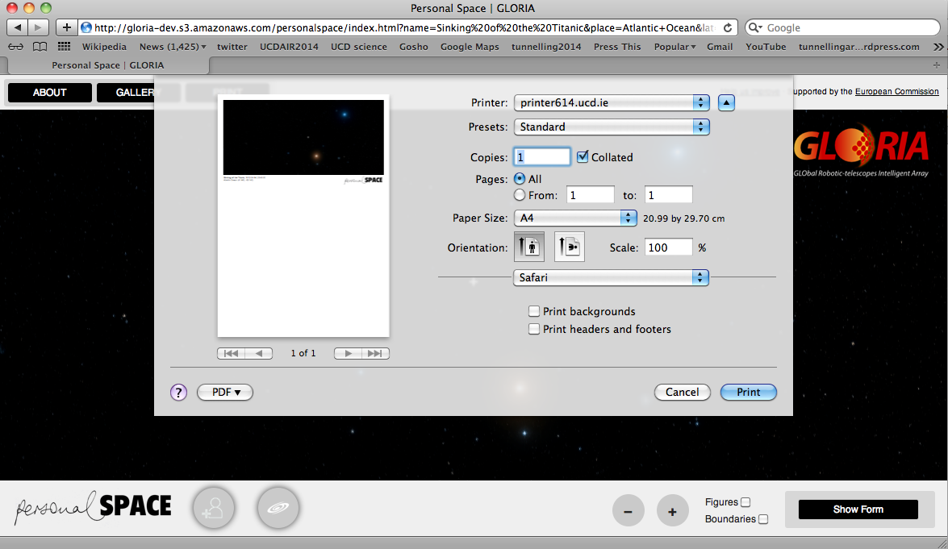

Slide 15
Future plans
Soon you will be able to request a live image of your Personal Space using the GLORIA network!
We will be develop Personal Space mobile apps
Add stellarium features (people want to know about the stars too!)
Personal Space will be translated into all the GLORIA community languages

