Slide 1
GLORIA Project community Open Day
Bologna, May 15, 2014
Ing. Matteo Di Carlo

Slide 2
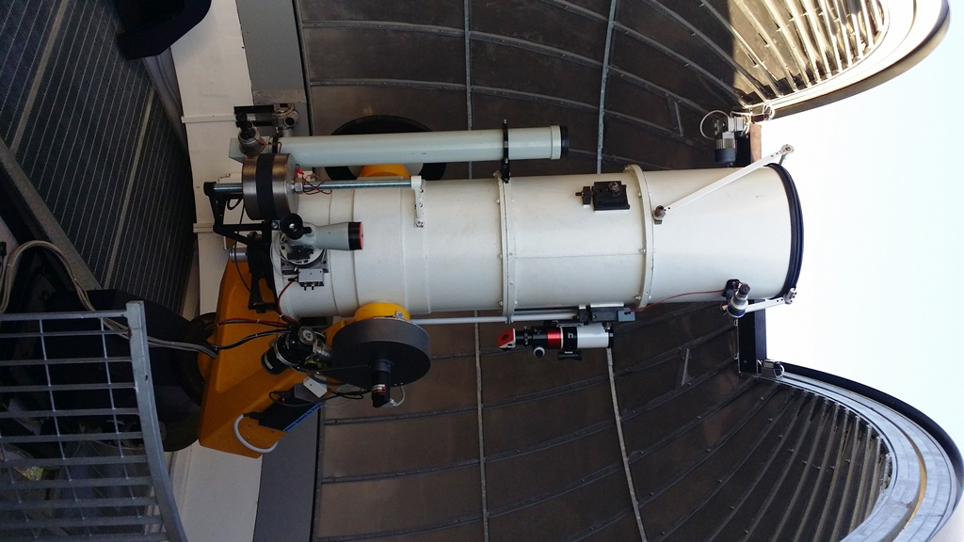
Teramo Observatory
The Teramo Observatory is provided with three telescopes (72-cm and 40-cm reflectors, plus a H-alpha solar refractor) equipped with focal plane instrumentation and devoted to remote observations.

Slide 3
TNT Main Technical Data
Aperture | 72 cm
Optical design | Ritchey-Chrétien
Focal length | 8.4
CCD | Apogee Alta U47 1024x1024
Pixel FOV | 0.27 /px
CCD Field | 4 x 4 arcmin2
Blind pointing accuracy | < 30 arcsec
Open-loop tracking accuracy | < 1 arcsec (5 minutes)
Closed-loop tracking accuracy | < 1 arcsec
Slew rate | 2.5°/sec

Slide 4
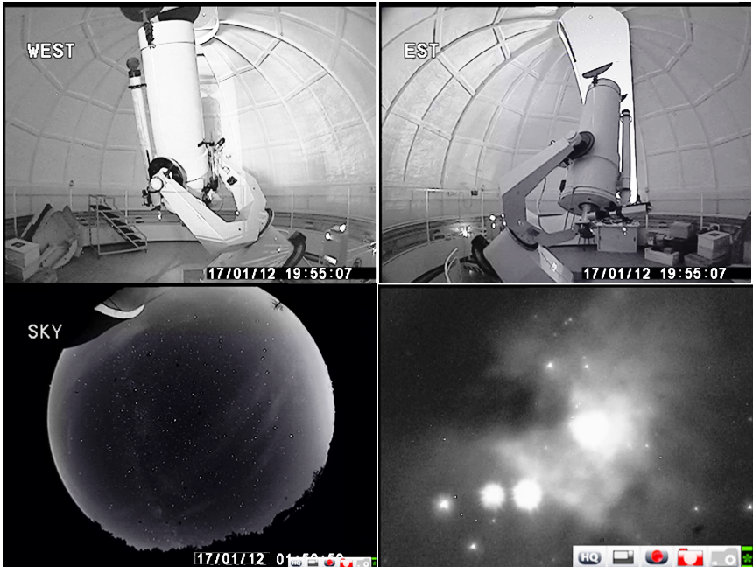
Remotization of the whole system
(safety, efficiency, and ease of use)
EAST/WEST Camera to control the Telescope and Dome position
All-sky (180°) camera to monitor weather conditions
Started in the year 2011 it has been completed at the beginning of the year 2012; It will be upgrated within the current year (new ccd, new cameras…)
Teramo Normale Telescope (72-cm) has already been upgraded to allow safe and full remote controls, without the need of local operators
Finder telescope for field recognition and guiding

Slide 5
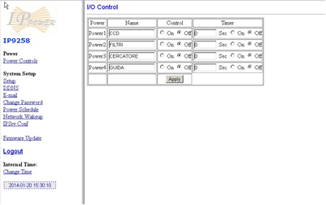
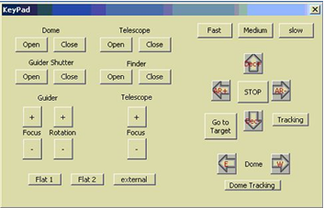
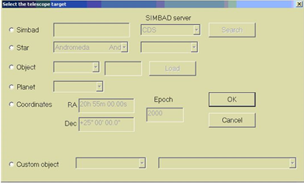
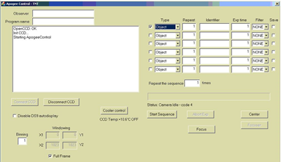
Educational projects
The TNT telescope is inserted in educational projects involving secondary schools
Students and teachers can carry out atronomical observations directly from the classroom at any time, by using a simple interface, that manages telescope pointings, ccd acquisitions and weather control

Slide 6
New technologies for museums and exhibition
Augmented reality: mobile application in order to integrate the telescope observation with new user experience
3D reconstructions for the main tools in the Teramo observatory Museum
Realization of new virtual museum areas to integrate other tool or object coming from different structure

Slide 7
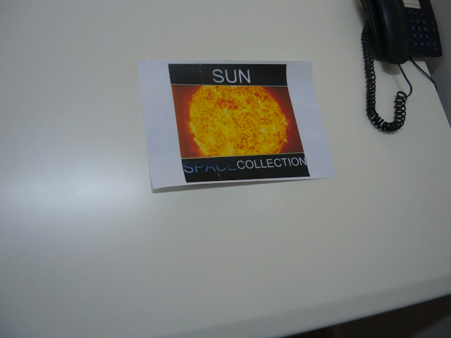
Augmented reality
Augmented reality (AR) is a live direct or indirect view of a physical, real-world environment whose elements are augmented (or supplemented) by computer-generated sensory input such as sound, video, graphics or GPS data

Slide 8
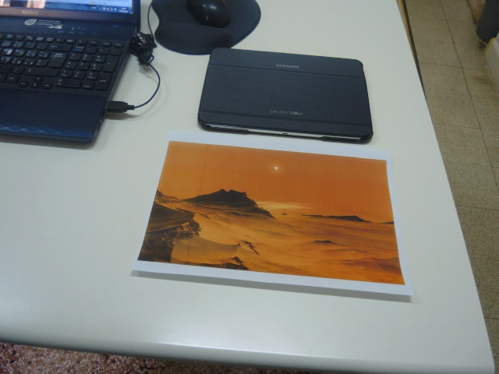
Sample Dimonstration

Slide 9
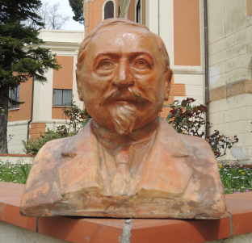
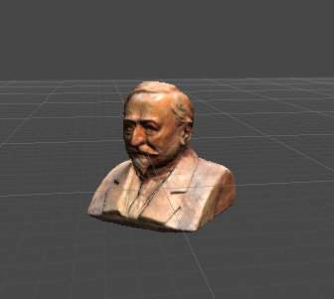
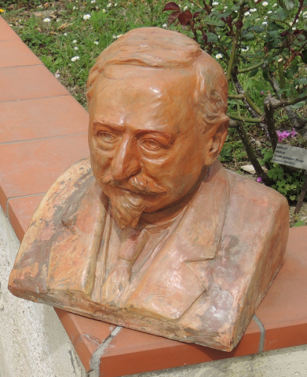
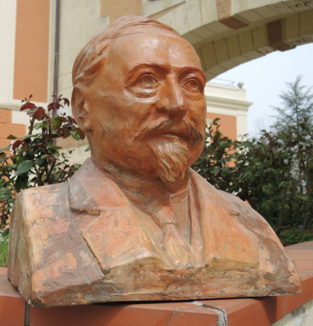
3D Reconstruction
Structure from motion algorithm (Yasutaka Furukawa's PMVS/CMVS)
Image-based modeling and rendering

Slide 10
Conclusion and future developement
New virtual museum areas
  Planet Room
  Kircher museum Room
Animation and modeling
Educational game project
Reference:
  matteo@oa-teramo.inaf.it
  valentini@oa-teramo.inaf.it

