Slide 1
Growing and Sustaining a Community of Telescope Users
John Baruch – Bradford Robotic Telescope

Slide 2
Robotic Telescopes for Everyone
John Baruch
University of Bradford
15 May 2014

Slide 3
Robotic Telescopes are much more important than you dreamed….
Newton introduced his laws of motion and changed the world…..
We are introducing Robotic telescopes with the potential to change the world!
How?

Slide 4
Newton
His three laws of motion were derived from astronomy….
They were applied elsewhere and powered the industrial revolution….
Machines of all kinds…
Steam Engines, Guns and Rockets
Railways and Cars
Petrol engines – jets and aircraft…

Slide 5
How can Astronomy repeat…..?
with Robot telescopes it can make a massive contributions to our economies……

Slide 6
Unemployment is a massive problem
Unemployment for the young
Unemployment for older people caught up in Change…
Change to move manufacturing to low wage economies
Change to move service industries to low wage economies

Slide 7
We need the skills for innovation and creativity – for a Knowledge Economy
It is developing the skills of innovation and creativity that robotic telescopes can deliver

Slide 8
What is the Knowledge Economy?
The World Bank, the UN and many other detail a knowledge economy and what it requires…
A knowledge economy is where design and innovation in new products and services is the key to the economy with robots doing the manufacturing and most of the services….
There are vast opportunities with innovation and creativity……

Slide 9
The Knowledge Economy
Robots make the mass produced products
People innovate to make the products better
Localisation of fashion and design in food furniture, clothing, and more specialist products such as classic cars….
Creative industries in film, TV, and all the new media…
Exploitation of the revolution in materials and bio materials making many new products possible.

Slide 10
Jobs in the Knowledge Economy
Jobs are essentially well paid and rewarding
Businesses tend to be small since large companies are generally very poor at innovating.
Markets tend to be web based and local but with a world wide interest as well.

Slide 11
Knowledge Economy Requirements
The fundamental requirement is an innovative and creative workforce.
In technological innovation the World Bank the UN and many others regard practical science the key to educating for innovation and creativity.
Practical Science is the route into a knowledge Economy…..Everyone agrees…..

Slide 12
Practical Science
Practical Science is a big problem for most countries.
They do not include practical science in their school curricula
Where it exists it is normally in after-school clubs
Science clubs
Raspberry pie clubs
Gardening and cooking are not totally removed from practical science but most schools have dropped them.

Slide 13
Practical Science (2)
Where practical science exists like in the UK it is regarded as expensive requiring:
Laboratories
Laboratory technicians
Teachers who can teach practical science

Slide 14
What is Practical Science?
Question the world around us…
Develop a theory as to why it is like it is…
Test out the theory with an experiment….
Evaluate the results of the experiment….
Was your theory true or not?
how far does it go in describing the real world?
How must you alter it to describe it better?
How can you further test it?

Slide 15
Practical Science
Practical science is about developing the skills of innovation and creativity…..
How can we do an experiment to test out our ideas about the real world?
How well will this experiment test out our theory?
How can we innovate and creatively make our experiment better?

Slide 16
Practical Science
Practical Science is about addressing problems and using the available technology to find a solution.
This is exactly the same challenge that small businesses face…..
How can I innovate and creatively make a solution to a problem:- a solution that I can sell?
What can I create that is entirely new and people will want?

Slide 17
How to deliver Practical Science?
Without trained teachers…..
Without laboratories or technicians…
Of course with Robots..... Robot science laboratories that you can access on the Web….

Slide 18
Germany decided to set up a Robot Chemistry Laboratory…..
I believe it closed this year after 15 years with little progress and many problems. I can no longer find it on the web.
No others have been tried apart from robotising a few chemistry and physics experiments…

Slide 19
Astronomy with Robots is Ideal
The whole laboratory is easily accessible: the universe goes over your head every night…
With a robot telescope you can do everything that astronomers can do.
Astronomy is the only practical science that can be robotised……

Slide 20
Astronomy can deliver Practical Science
The key for practical science is
being innovative and creative in the experiments to test out your ideas
Thinking about why and how and how better…..
Having the tools to analyse the results……

Slide 21
The Bradford Robotic Telescope(BRT)
The Bradford Robotic is an example of this
There are dozens of experiments that students can do in optical astronomy covering all the curricula that we know up to first year university.
They need to think why these experiments and how they can make them better…..
The BRT delivers Practical Science……
Practical science develops the skills of innovation and creativity…..

Slide 22
Practical Science – Do governments know?
Yes and no.
This year the Bradford Robotic Telescope led the presentation to the British Government from the research Council showing how we were contributing to building a knowledge economy…
In Ireland, China and Poland there are projects going on to demonstrate the value of astronomy
Nature 13 March 2014 has a piece about the importance of practical science and robotic telescopes

Slide 23
e.g. Practical Science in China
Practical Science is not taught in Chinese Schools
The Chinese Government is very keen to include creativity and innovation in their education system….
they see practical science as a route to developing innovation and creativity….

Slide 24
The Chinese Examination System
In China everything is determined by your marks in the Chinese School Leaving Examination – the Gaokao： 高考。
This year a pilot programme is running in the Beijing Area (about 30 mllion people) in which a practical science project can contribute to the Gaokao marks.
The only project listed is the Bradford Robotic Telescope!

Slide 25
The Future for Robotic Telescopes
In Europe….
A major item must be delivering practical science for school children.
We would be very pleased to work with others to develop such a practical science network.
A telescope which delivers practical science for 50% of the time can spend the remaining 50% servicing research and amateur astronomers.

Slide 26
Delivering Practical Science
99.9% of the BRT users developing innovation and creativity follow the paths laid out and ask for standard observations. Thus we can service a million users.
We now have 150,000 users. Most are school children and they have the priority. Most of the telescope time is taken with amateur astronomers and research programmes.
BUT the BRT needs to be introduced by Astronomers…

Slide 27
Space is also really exciting.....
Rosetta
Mars
The new interest in the Moon
The search for life
The new really big telescopes
Gravitational Waves….

Slide 28
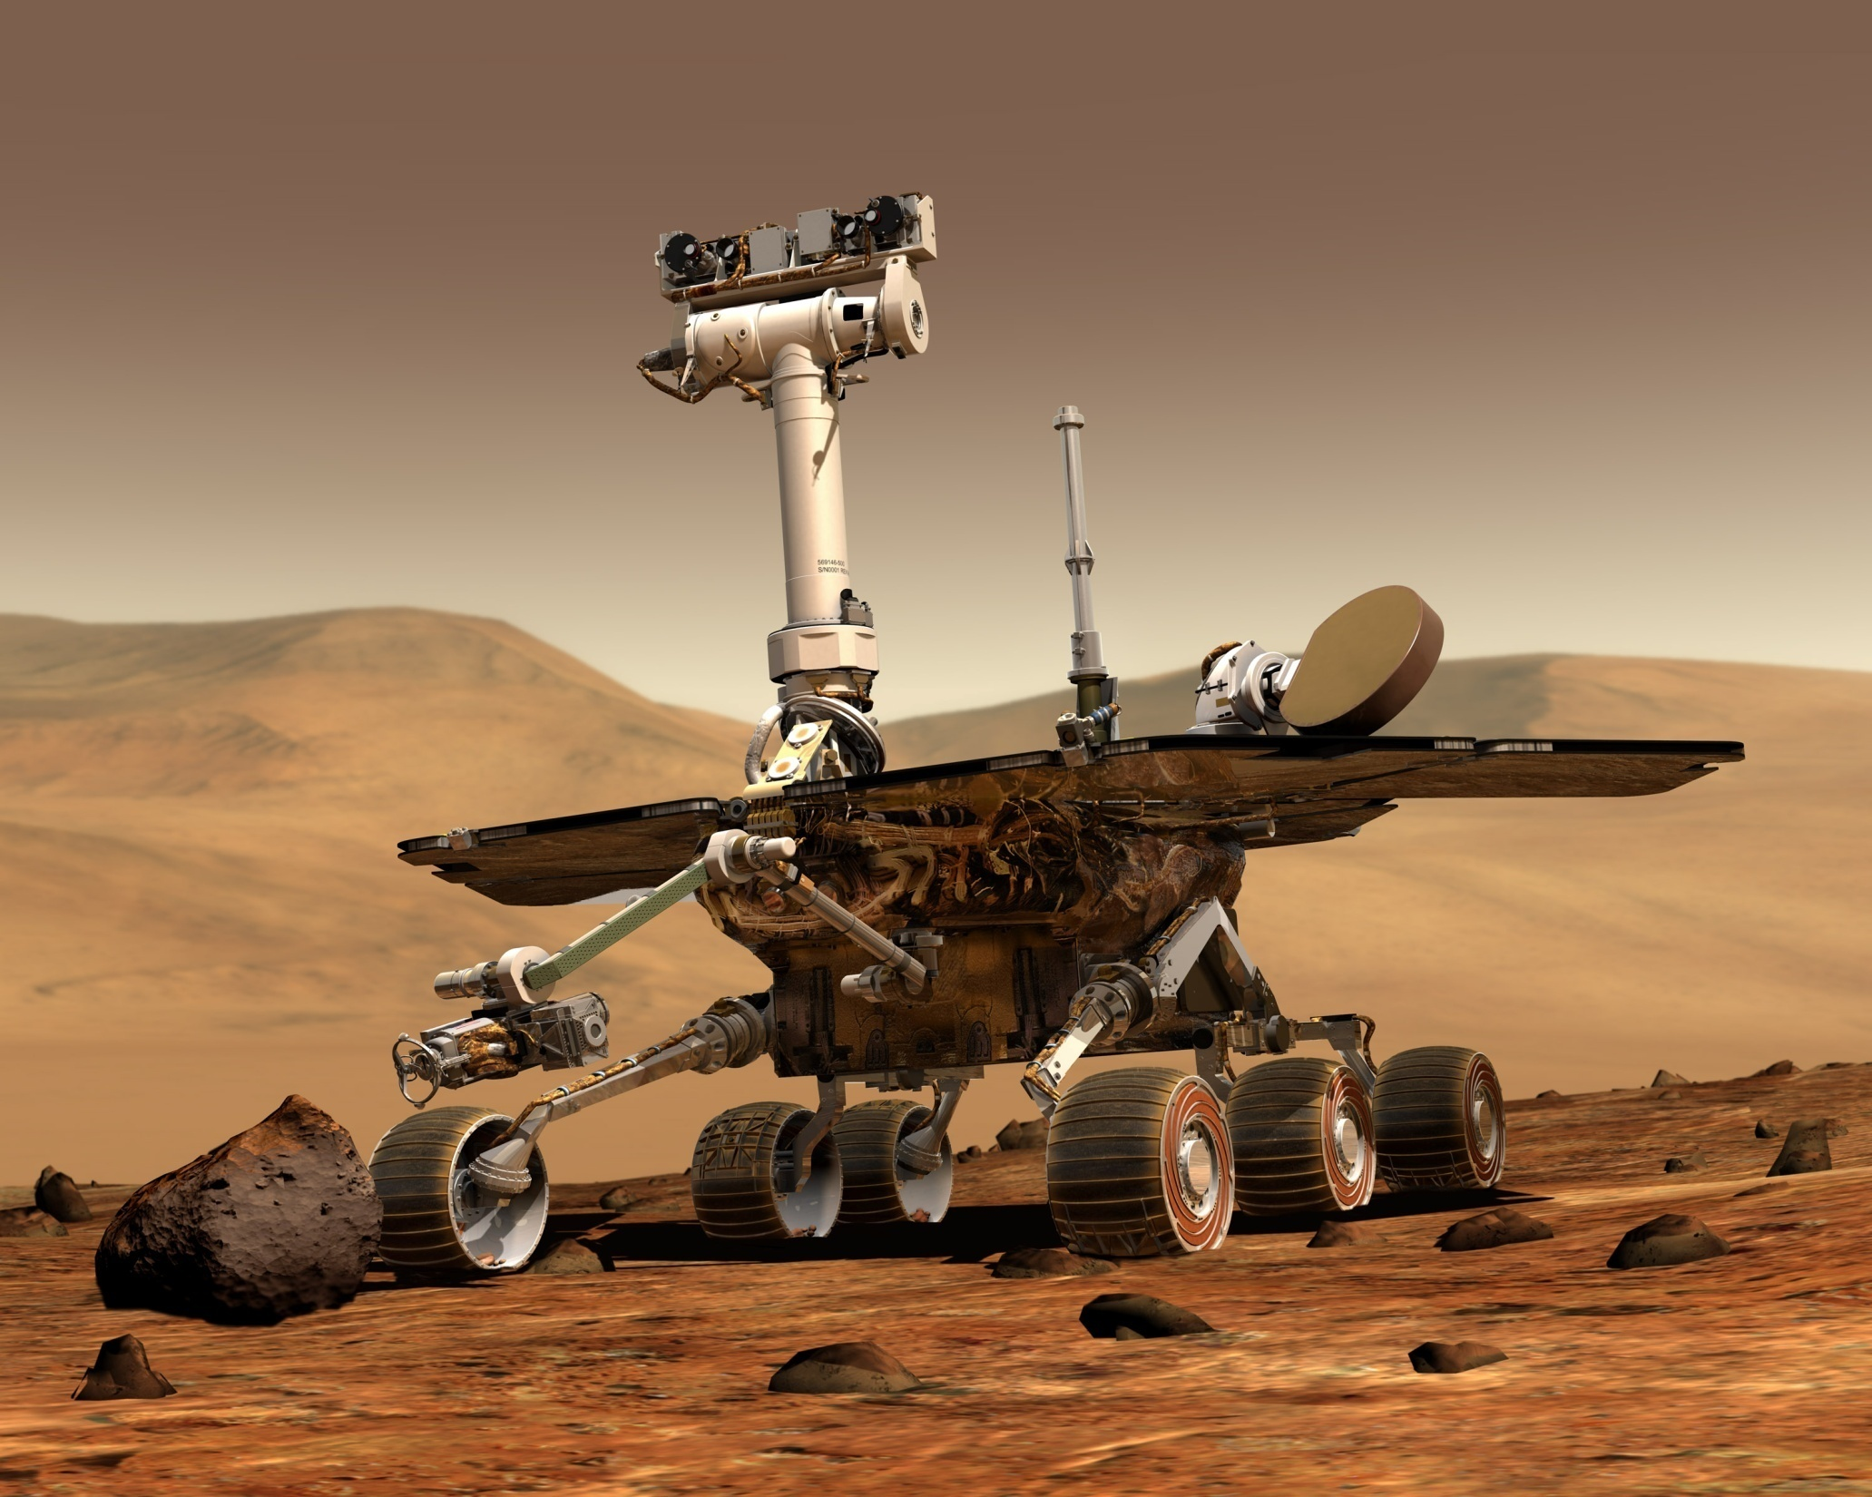

Slide 29
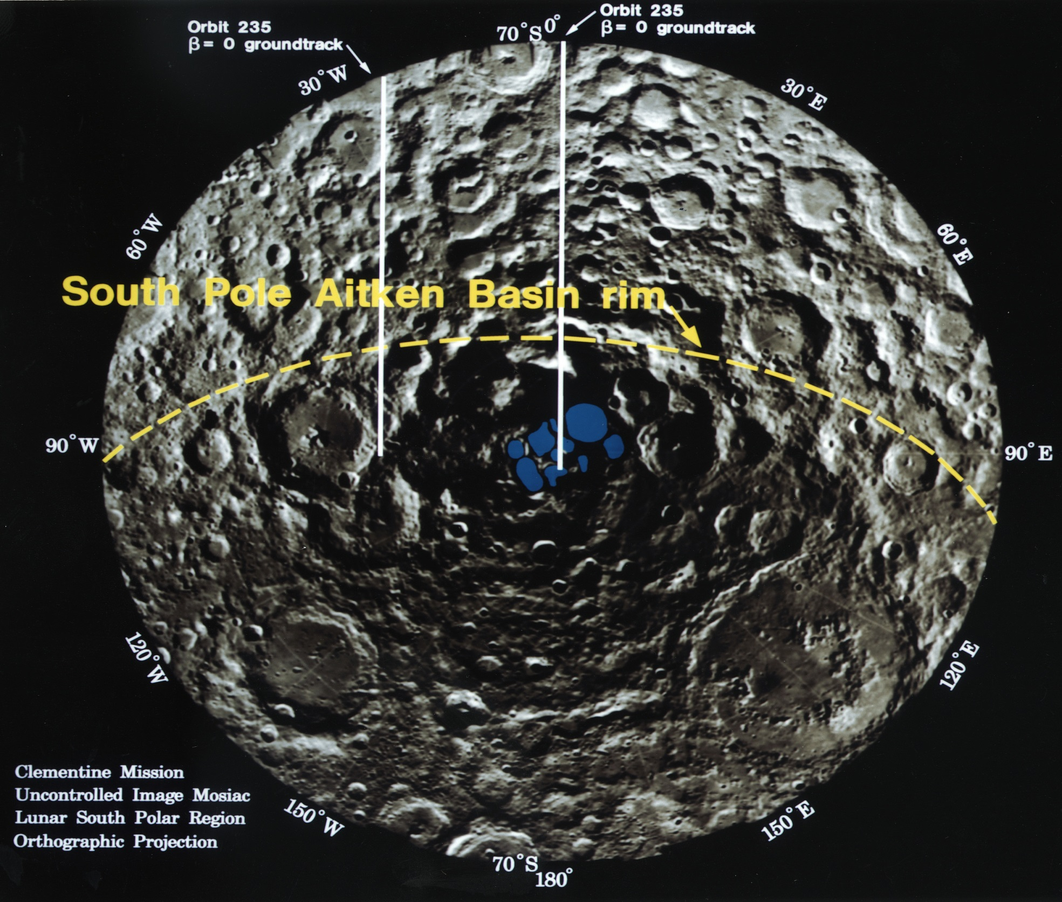

Slide 30
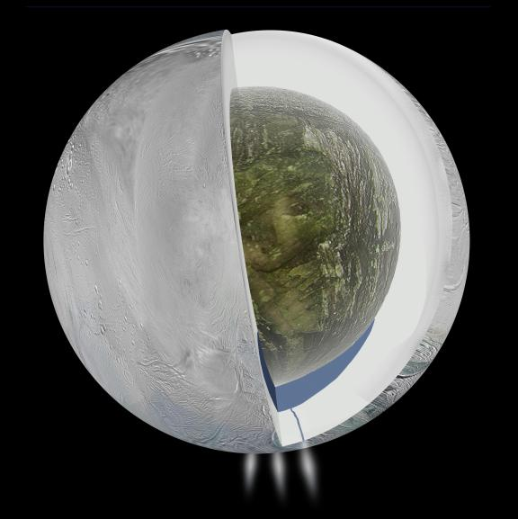

Slide 32
The best finder of planets:
The Nasa Kepler Satellite:

Slide 33
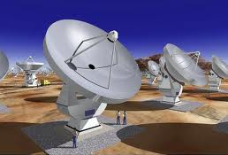
Radio Telescope: total area 1km square

Slide 34
Bigger telescopes: 40m

Slide 35
A new description of the Universe in 2009
Not Billions of galaxies with billions of stars
Now Billions of galaxies with billions of PLANETS

Slide 36
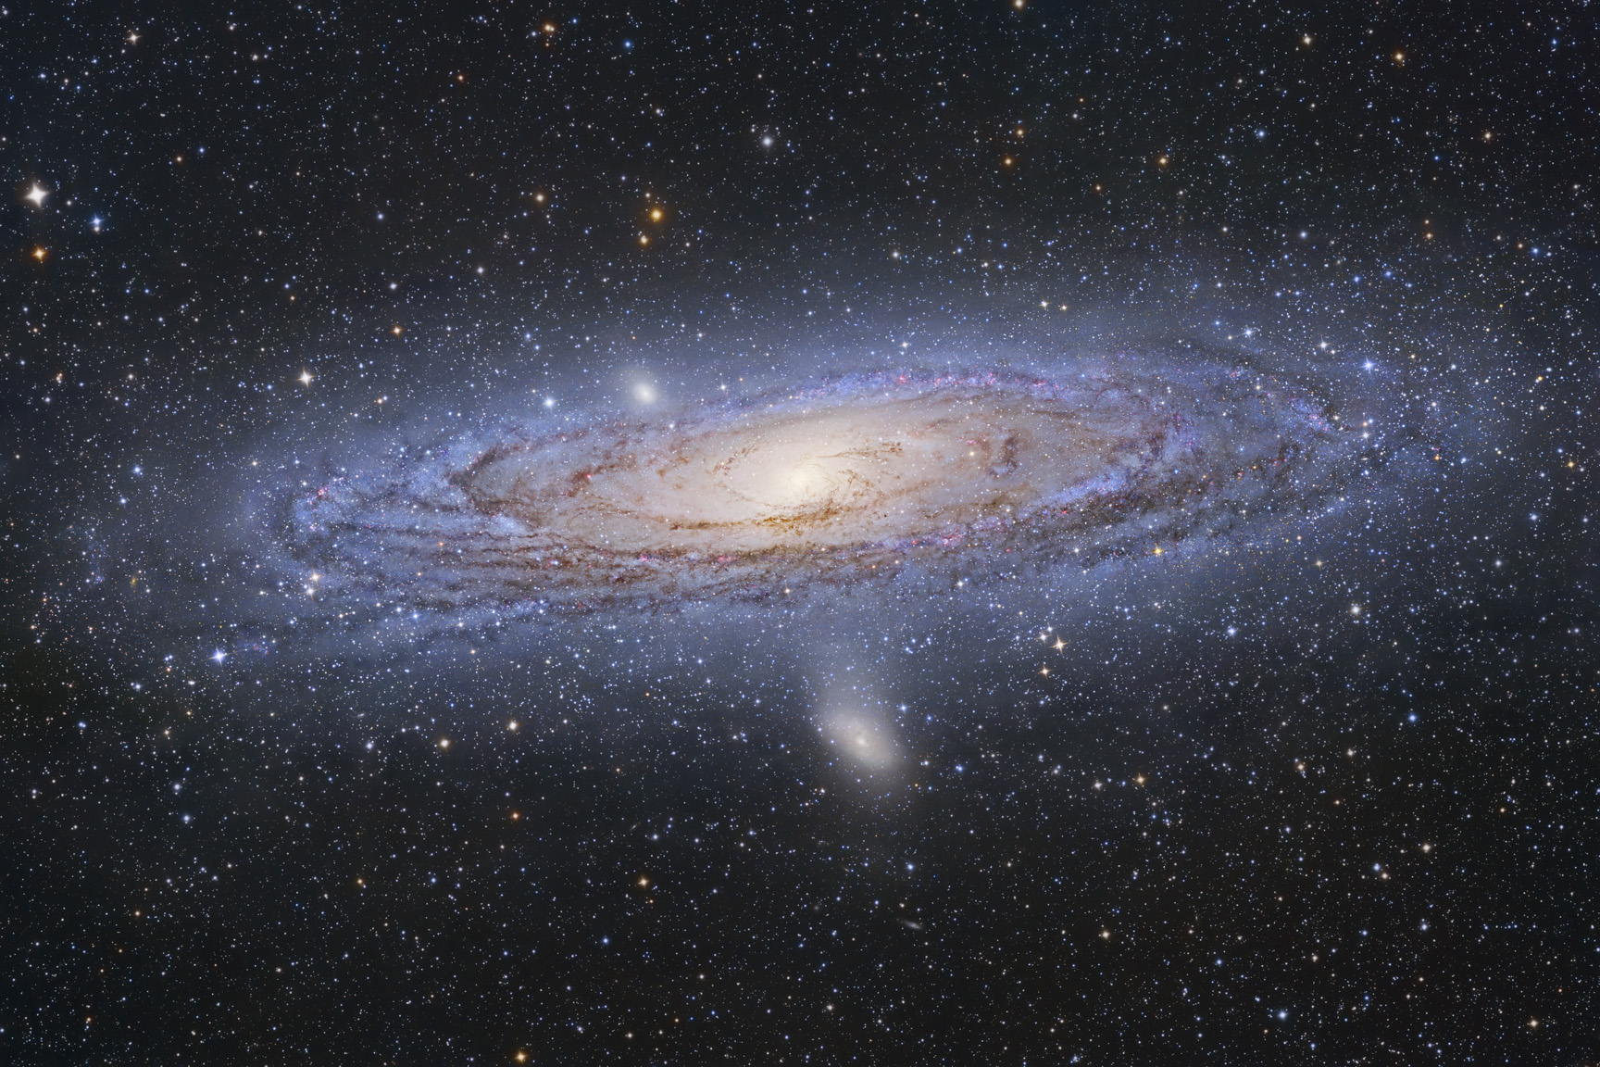

Slide 37
A Robotic Telescope for Practical Science

Slide 38
Astronomy: Exciting and Important
Astronomy does hold a key to generating jobs in future knowledge economies.
How can astronomers with robotic telescopes deliver
How can they persuade Government that they are still as important as Newton……

Slide 39
We need to create jobs for our people
The skills of innovation and creativity open up the Knowledge Economy….
Practical Science is the route into developing technological innovation and creativity
Astronomy is the only practical science that can be robotised and delivered on a mass basis.
Robot Telescopes can change the world……

Slide 40
Thank – you http://www.telescope.org http://schools.telescope.org

Slide 42
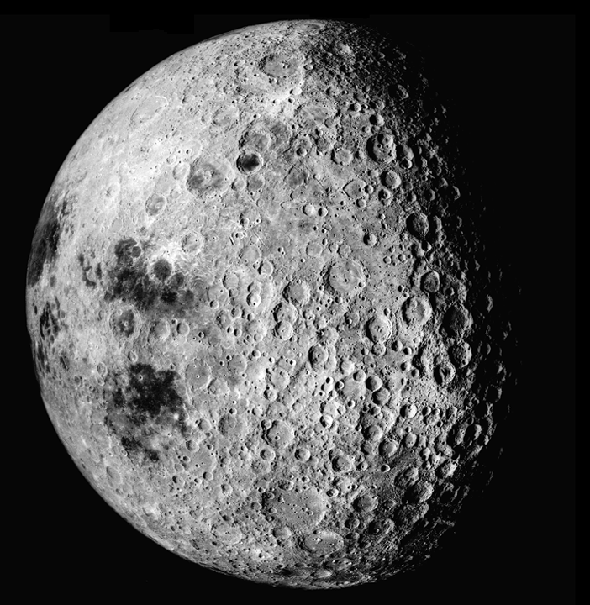

Slide 43
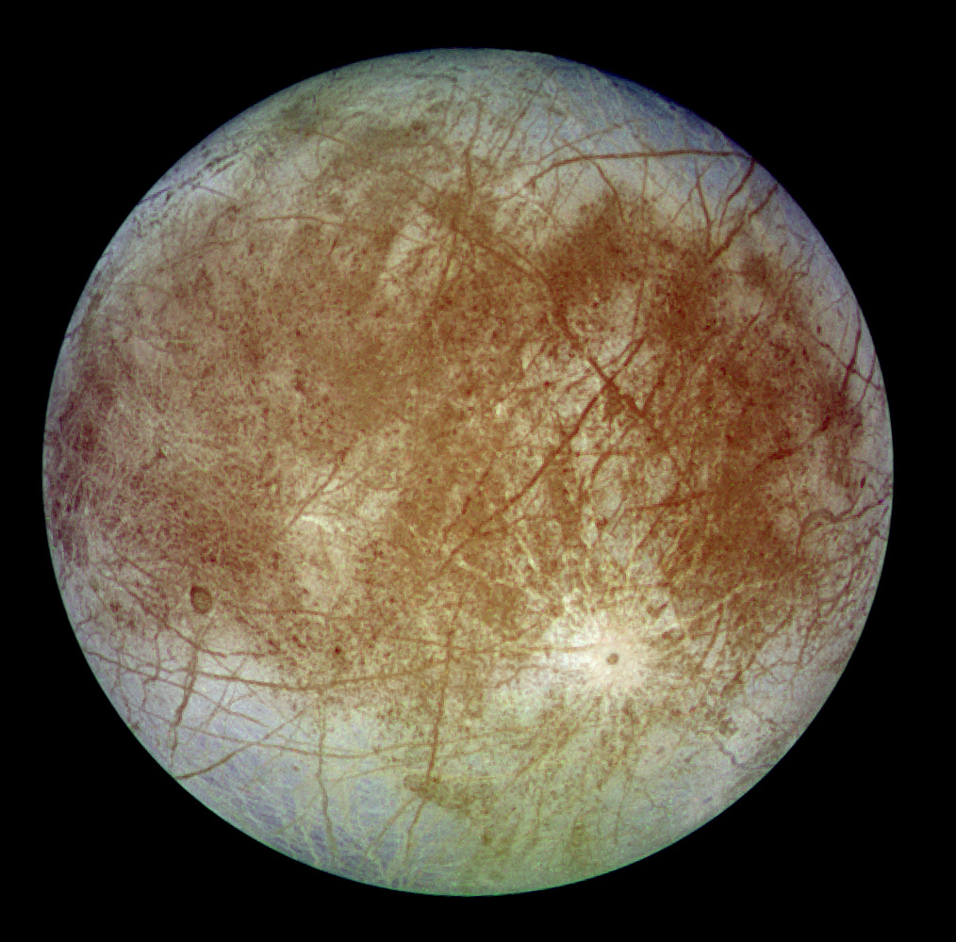

Slide 44
Details of the surface of Europa

Slide 45
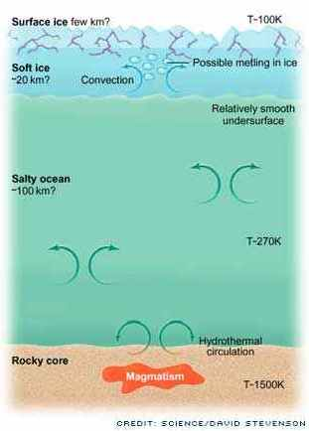
Europa

Slide 46
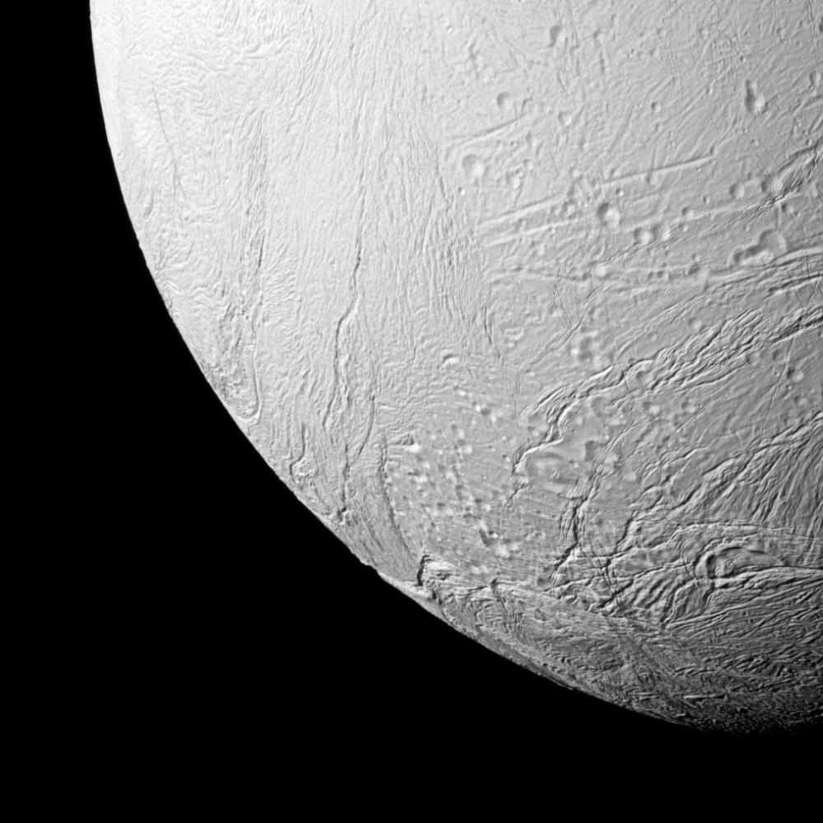

Slide 47
There is a great interest in finding Earth like planets
Bigger telescopes
SETI
Radio telescopes

Slide 48
Our Galaxy- the Milky Way
200,000 Million stars
With the chance of finding an Earth like planet the same as winning the lottery about 1 in 14 million
There will be about 14,000 Earths in our Galaxy! – not the large Earth-like planets found almost every week.

Slide 49
We live in exciting times
When I went to school…
Only 9 planets - Pluto
This week we have reached 4624 possible exo-planets going around 764 stars with 1022 confirmed almost all within 300 light years of our Sun. Our galaxy is 100,000 light years in diameter (0.3%)

Slide 51
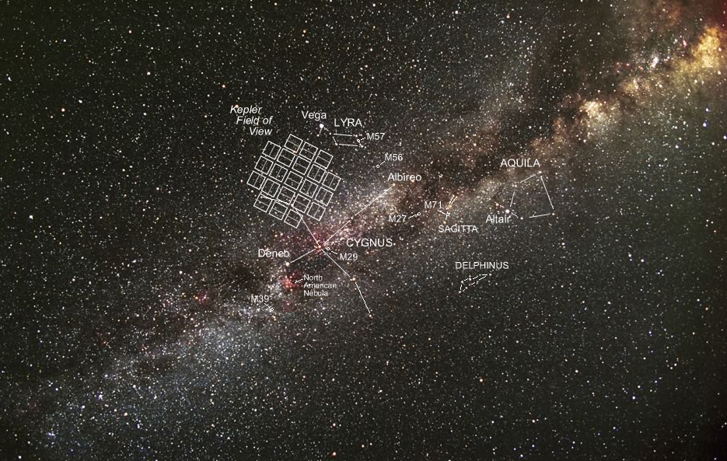
Kepler stares at thousands of nearby Stars

Slide 52
In this small area of sky Kepler has found:-
2165 Double eclipsing stars
3538 Possible planets
242 Confirmed planets
5 Rocky planets

Slide 53
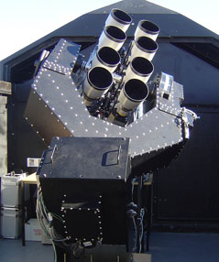
Tatoo
The Super Wasp Planet finder in the Canary Islands
65 planets found.

Slide 54
.

Slide 56
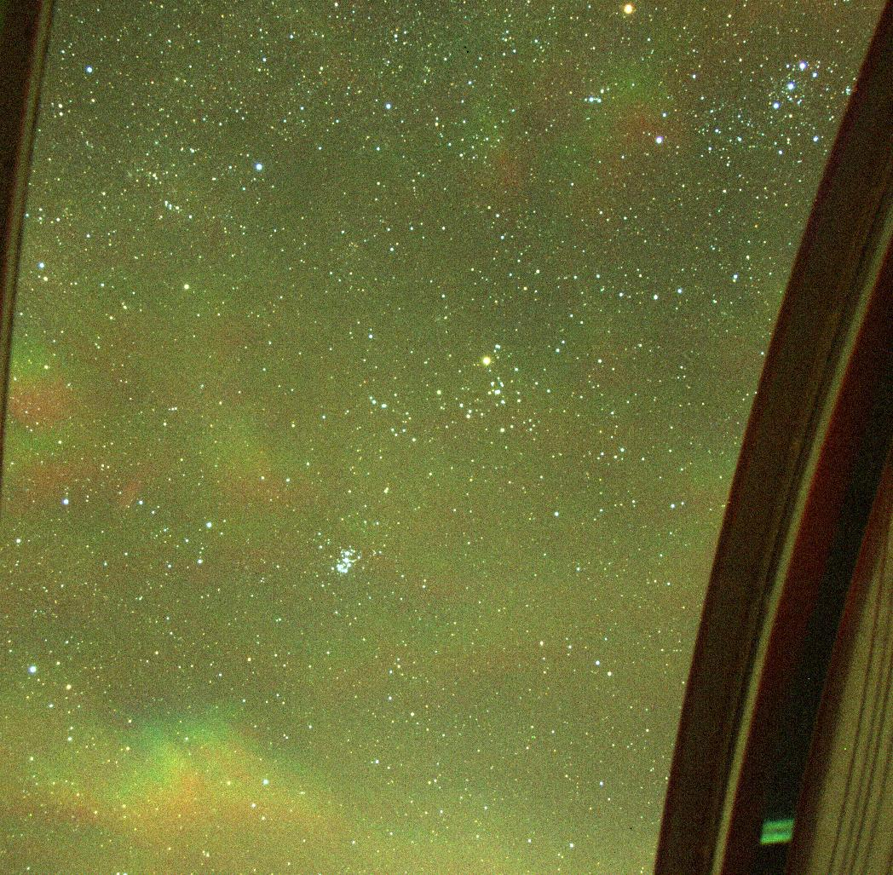

Slide 57
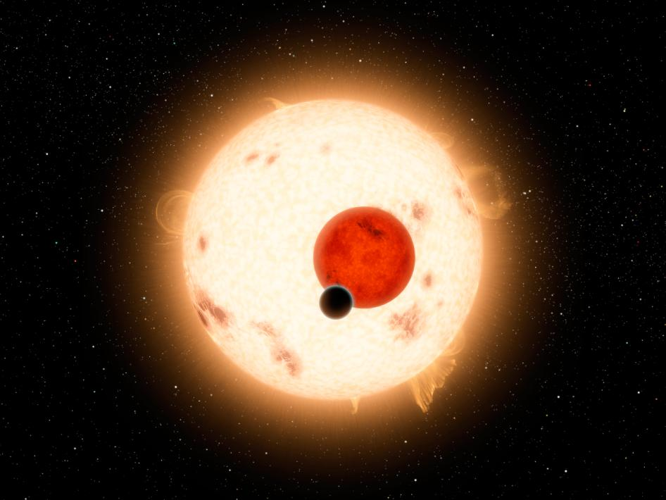
Tatooine?

